Slide 1
LENDING CLUB CASE STUDY SUBMISSION
Name: Utkarsh Tripathi
Name: Swarn Singh

Slide 2
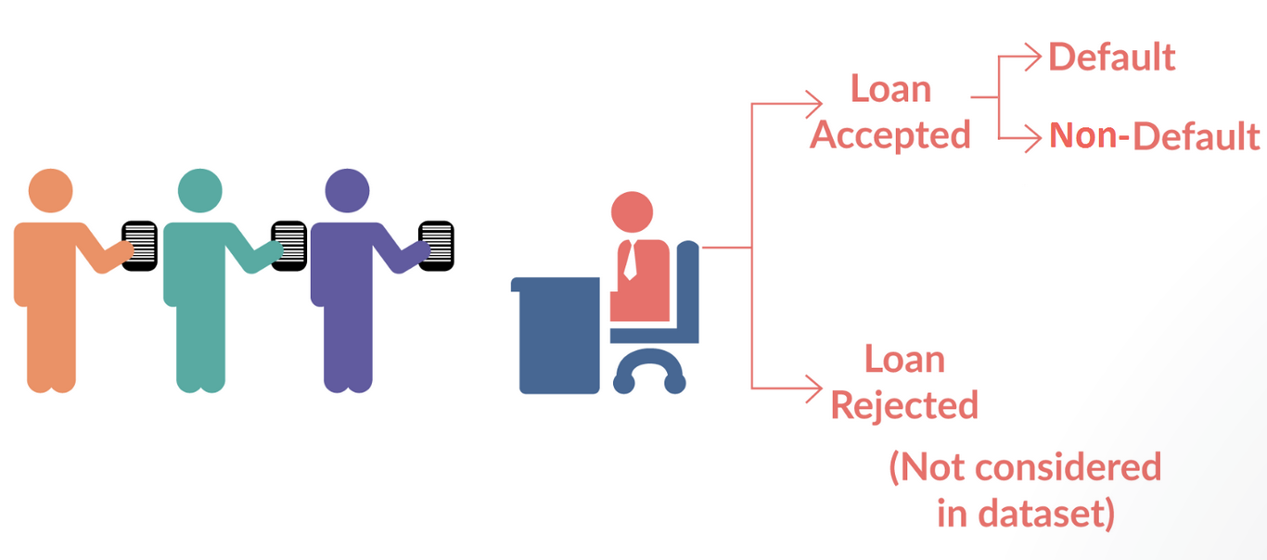
Business Problem
The Business problem can be summarised with the help of below picture
The problem is whether a person should be given loan or not. Top factors has to be identified using data exploration and analysis which can help us in identifying if a person will default on loan.
Two types of risks are associated with the bank’s decision:
1.) If the applicant is likely to repay the loan, then not approving the loan results in a loss of business to the company
2.) If the applicant is not likely to repay the loan, i.e. he/she is likely to default, then approving the loan may lead to a financial loss for the company

Slide 3
Problem solving methodology
Identifying the Business Objective
Exploring the Data, Identifying Missing values
Missing Values Treatment, Outlier Check
Dropping Rows, Imputation,
Changing Data Format
Data Understanding
Data Cleaning and Manipulation
Data Analysis and Conclusion
Problem Understanding
Univariate and Bivariate Analysis
Understanding the meaning of columns
Identifying the factors responsible for loan default

Slide 4
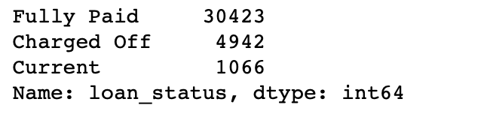
Data Understanding
Initially we have 39717 rows and 111 Columns in loan dataset provided to us
There are around 56 columns with more than 90% Null Values of which some has 100% Null Values
57 Columns has more than 60% Null values (including above 56)
The `loan status` column has 3 unique values:
Initially there are 2 columns which have all values as `0`.

Slide 5
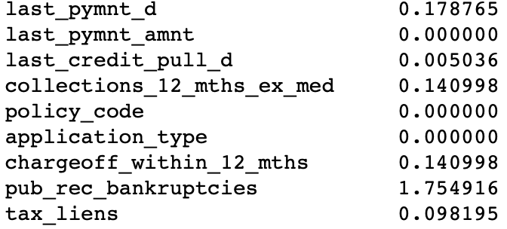
Data Cleaning
Dropped all the columns with more than 60% Null Values
Dropped all the columns with only 1 unique value (all `0`s)
After above cleaning there are few more columns with some missing values. Following are columns with percentage of missing values:
Dropping all rows having even single Null value.
After above step, check for number of unique values in each columns once more. 3 columns have only 1 unique value.
Dropping the above 3 columns as well along with Id columns on which analysis can’t be done
Also, we can’t do analysis where loan is currently running. Dropping these as well.
Assigning 1: `Charged off ` and 0: `Completed` for values of `loan_status`.

Slide 6
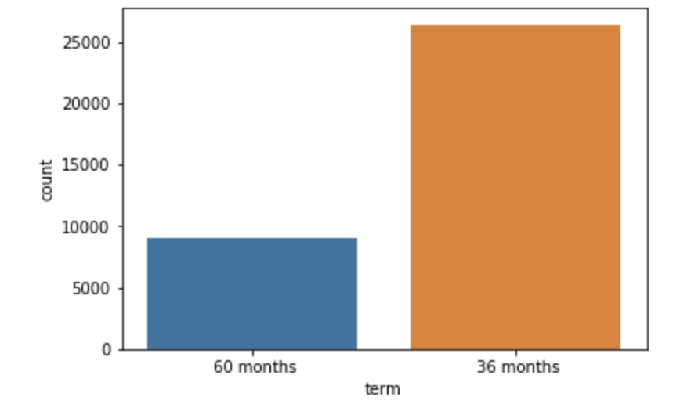
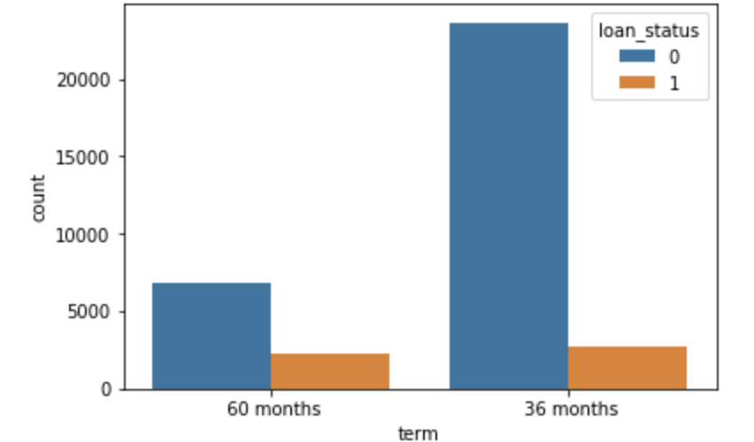
EDA: Univariate and Bivariate Analysis
Impact of Loan Tenure of Loan Status
1.) Most of the loans are given for tenure of 36 months
2.) Also the number of defaulters in both the tenures are same, but the proportion of defaulters in `60 months` tenure is obviously high as seen from 2nd graph.

Slide 7
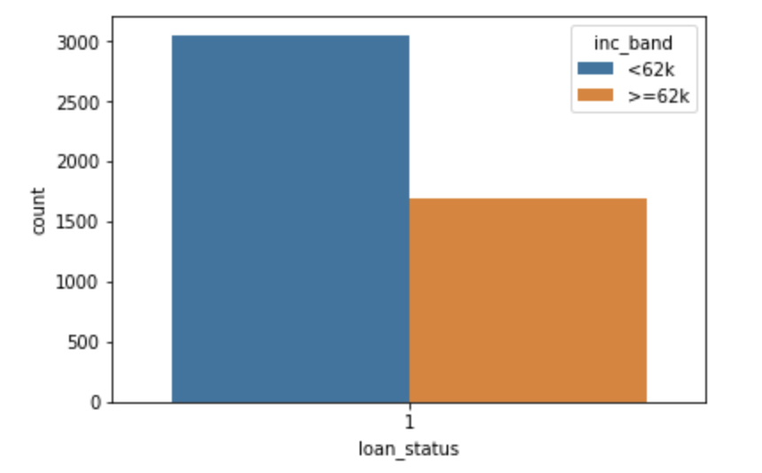
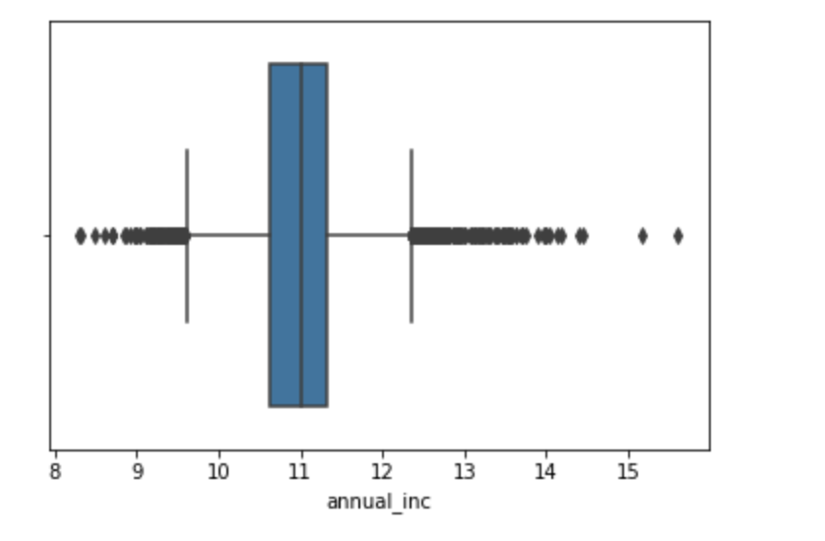
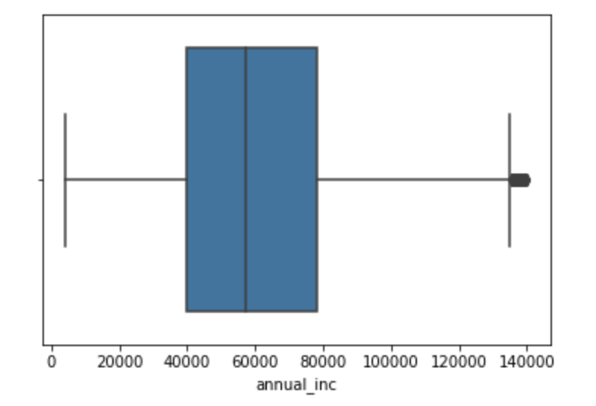
EDA: Univariate and Bivariate Analysis
Analysis of `Annual Income` Column
2.)
1.)
1.) Initially there were lot of outliers in the `annual income` ( 1) pic)
2.) But around 95% of people have income `< = 140k`. Analysis is done on this only. After filtering, box plot almost becomes ok with very few outliers (3) pic)
3.) Mean income for these is 62K.
4.) Around 65% of defaulters have annual income less than 62K. Hence `annual income` is a major criteria which should be check.
3.)

Slide 8
EDA: Univariate and Bivariate Analysis
Analysis of `Annual Income` Column
2.)
1.)
1.) Initially there were lot of outliers in the `annual income` ( 1st pic)
2.) But around 95% of people have income `< = 140k`. Analysis is done on this only. After filtering, box plot almost becomes ok with very few outliers (3rd pic)
3.) Mean income for these is 62K.
4.) Around 65% of defaulters have annual income less than 62K. Hence `annual income` is a major criteria which should be check.
3.)

Slide 9
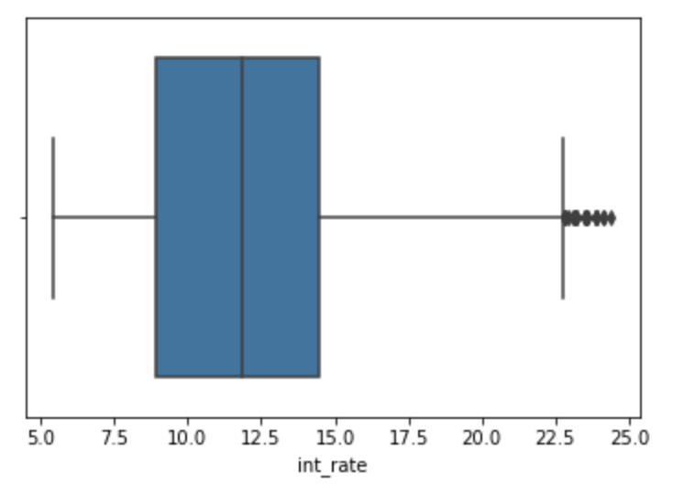
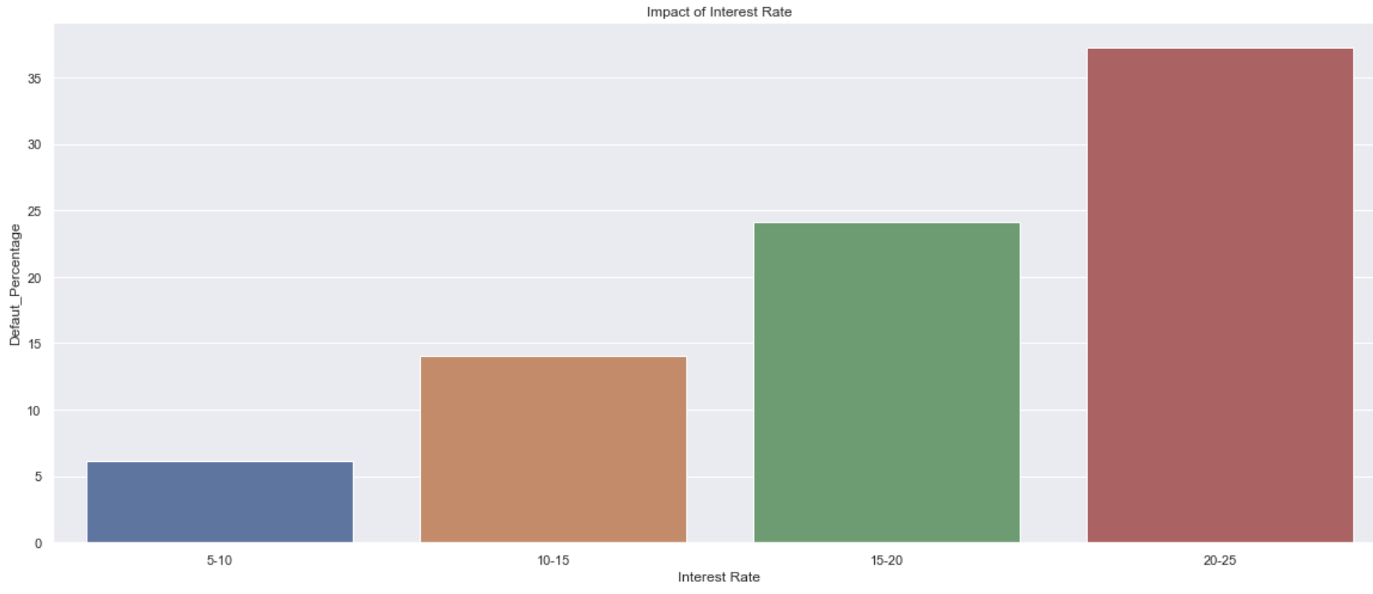
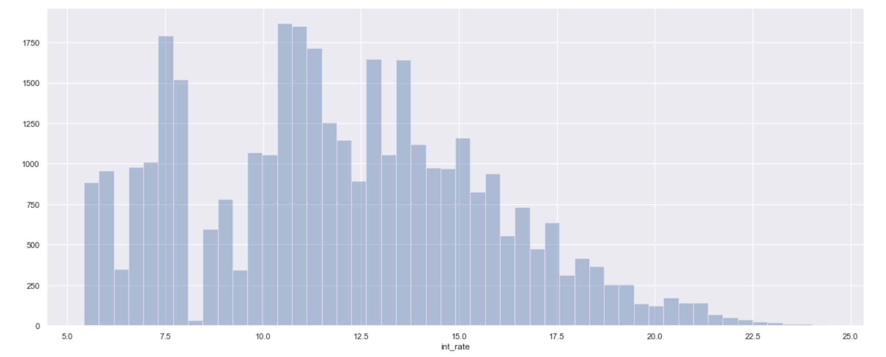
EDA: Univariate and Bivariate Analysis
Impact of `Interest Rate` on `Loan Default` Column
3.)
1.)
2.)
1.) Most of the applicants have interest rate within 20% as
can be seen from 2nd graph
2.) Also, as the interest rate increases chance of loan
becoming default also increases.

